Slide 1
Patterns of single gene inheritance

Slide 2
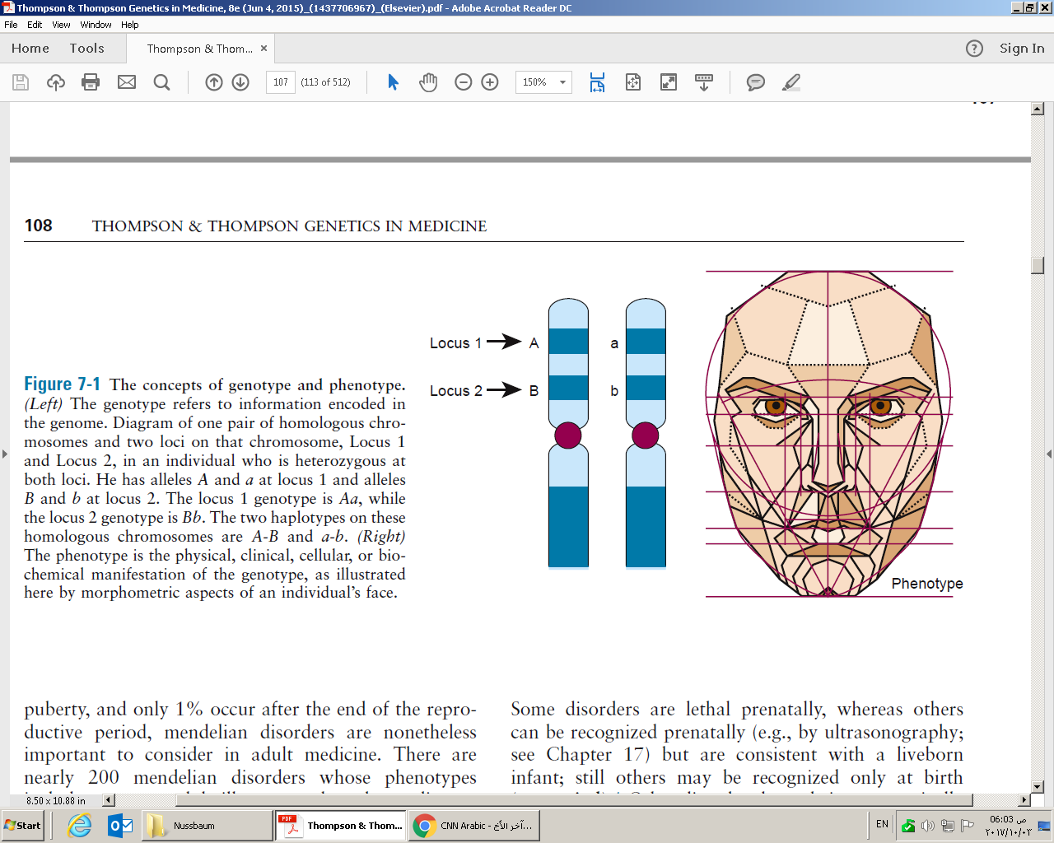
Genotype
Haplotype
Phenotype

Slide 3
Homozygous
Heterozygous
Compound heterozygous
Hemizygous
Single-gene disorder
Mendelian disorders
Mendelian inheritance in Man (OMIM)
Pleiotropy
Penetrance
Congenital
Expressivity

Slide 4
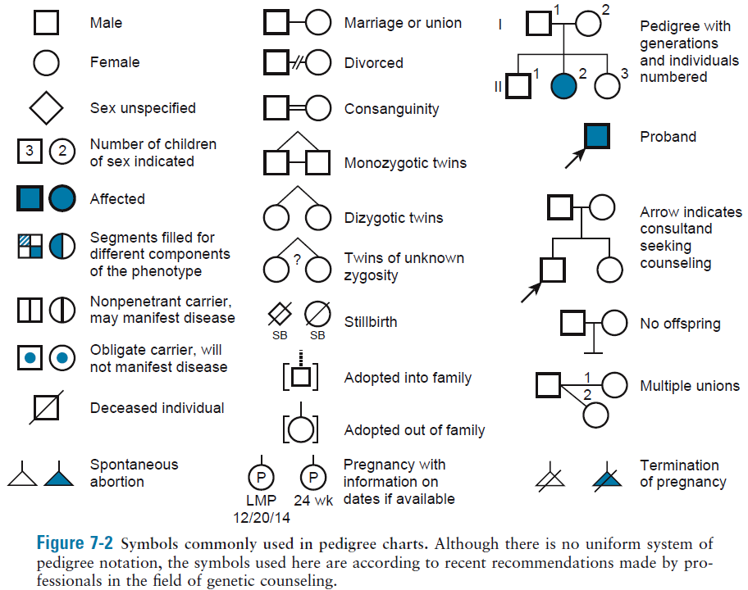

Slide 5
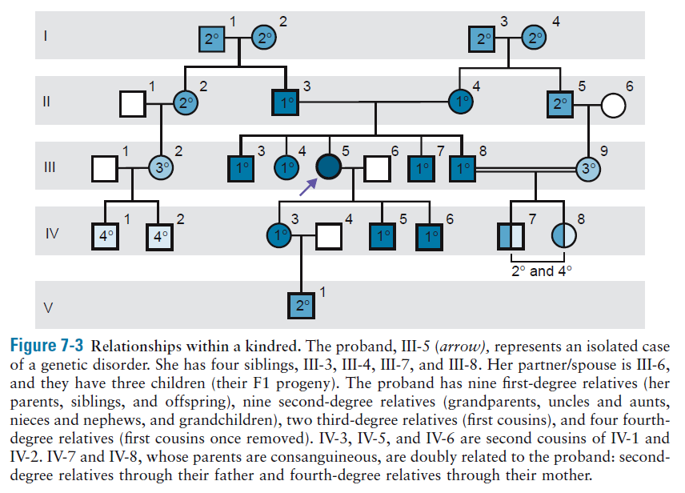

Slide 6
Siblings – Sibs
First degree, second degree, third degree relatives
First cousins, first cousins once removed, second cousins
Consanguineous
Isolated case – the only affected
Sporadic – new mutation

Slide 7
Complications of discerning inheritance pattern:
Lethal disorder affecting the fetus
Variable age of onset
Reduced penetrance, variable expressivity
Small family size

Slide 8
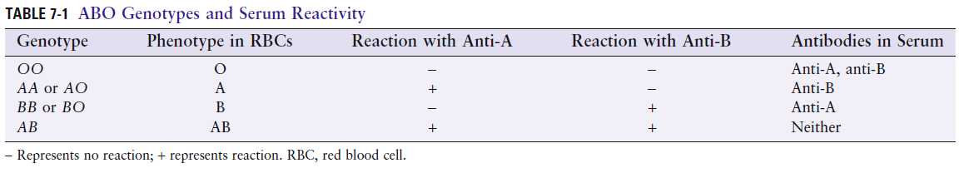
Recessive
Dominant
Incompletely dominant
Pure dominant AA=Aa
codominant

Slide 9
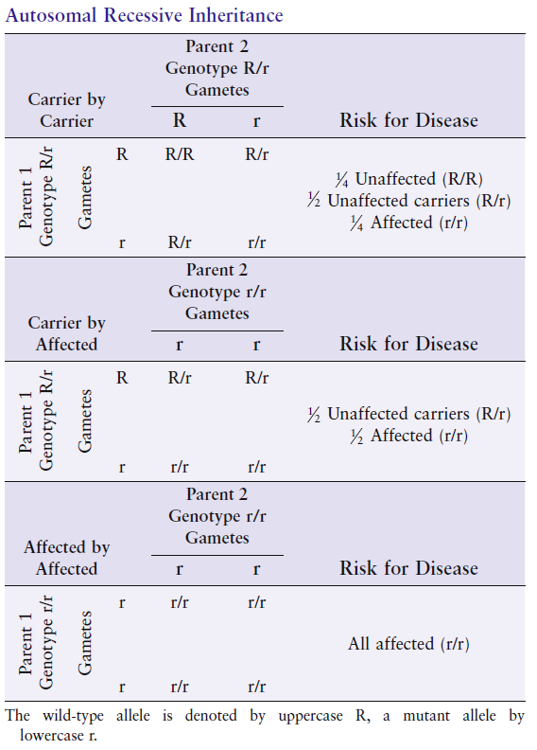

Slide 10
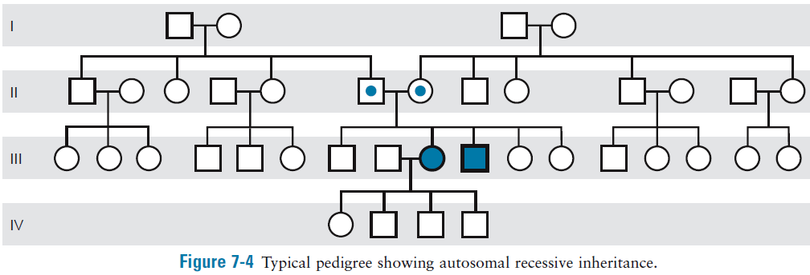

Slide 11
Sex-influenced autosomal recessive disorders
Hereditary hemochromatosis
5-10 times more common in males

Slide 12
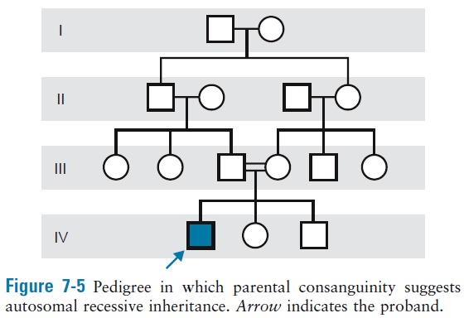
Cystic fibrosis-common
Xeroderma pigmentosum-rare
20% due to consang
Consang 0.1-1% in Western
Up to 50% in other pops
Consanguinity is more frequently found in the background of patients with very rare conditions than in those with more common recessive conditions
The genetic risk to the offspring of marriage between relatives is not as great as is sometimes imagined, only twice (3-5%) those of unrelated (2-3%)

Slide 13
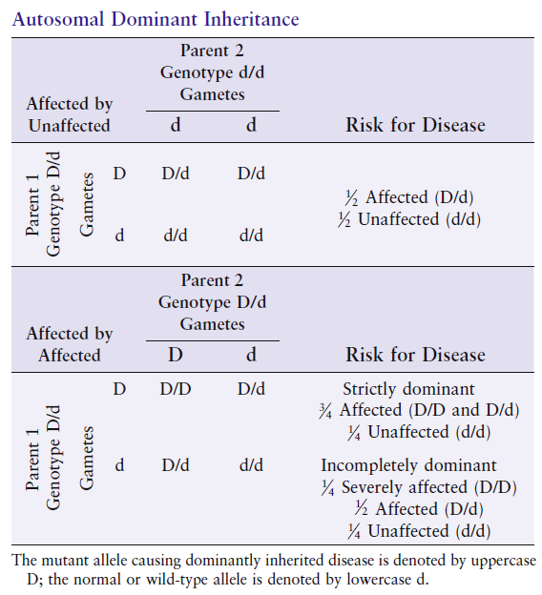

Slide 14
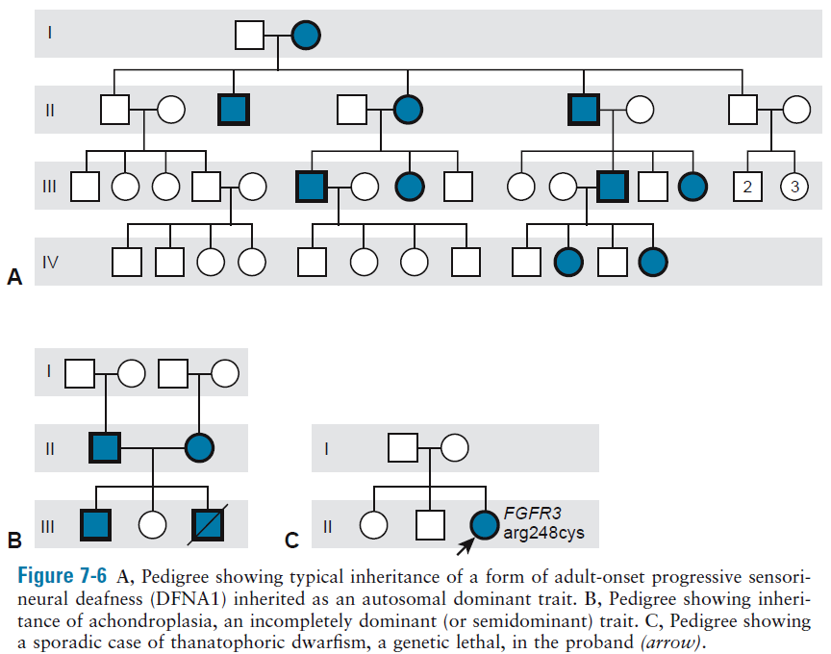

Slide 15
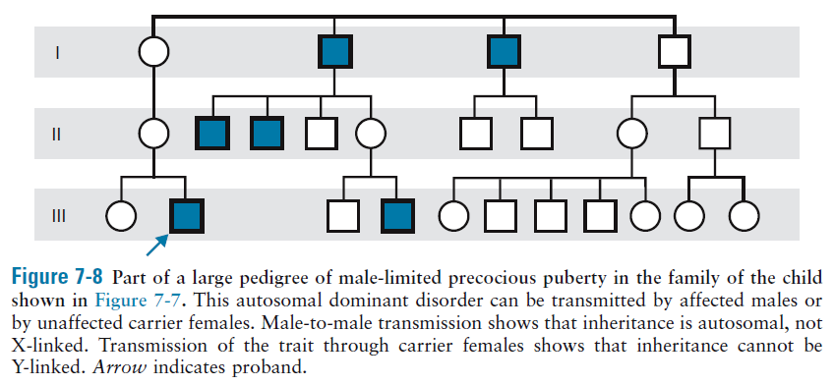
Sex-limited autosomal dominant disease
Defect is autosomally transmitted but expressed in only one sex

Slide 16
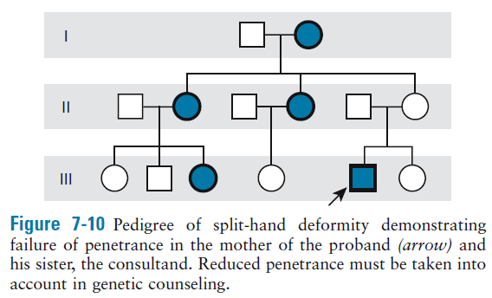
Effect of incomplete penetrance, variable expressivity, and new mutations on autosomal dominant inheritance patterns
Neurofibromatosis:
Age-dependent penetrance and variable expressivity

Slide 17
Fitness:
A measure of the impact of a condition on reproduction (0-1)
0 fitness → genetic lethal, e.g. thanatophoric dwarfism (all new mutation)
1 fitness, e.g. late-onset progressive hearing loss (inherited)

Slide 18
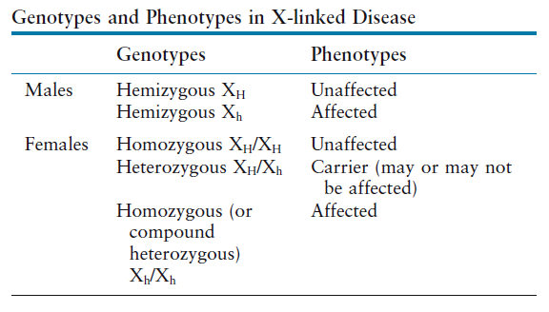
X-linked inheritance
X chromosome harbors 1100 genes (800 protein-coding)
300 genes are associated with X-linked disease phenotypes

Slide 19
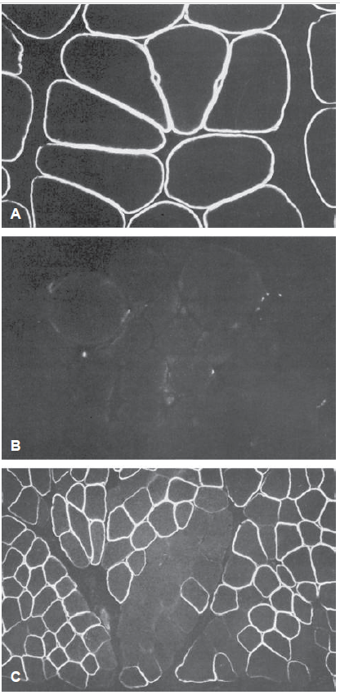
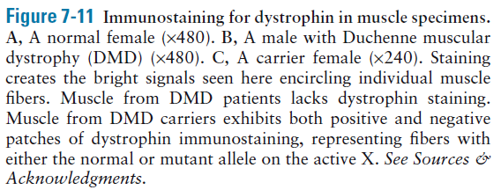
X-inactivation effect on X-linked disease
Dominance and recessiveness describe a continuum of penetrance and expressivity in female carriers of X-linked disease

Slide 20
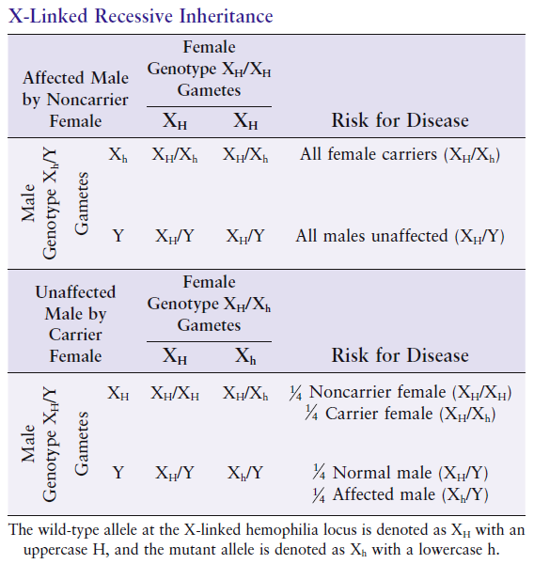
Generally restricted to males
Hemophilia A

Slide 21
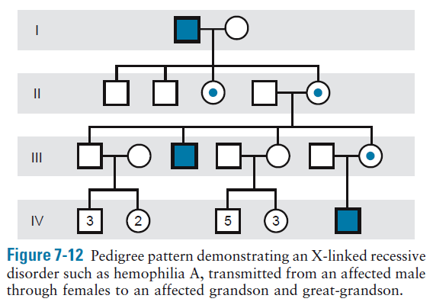

Slide 22
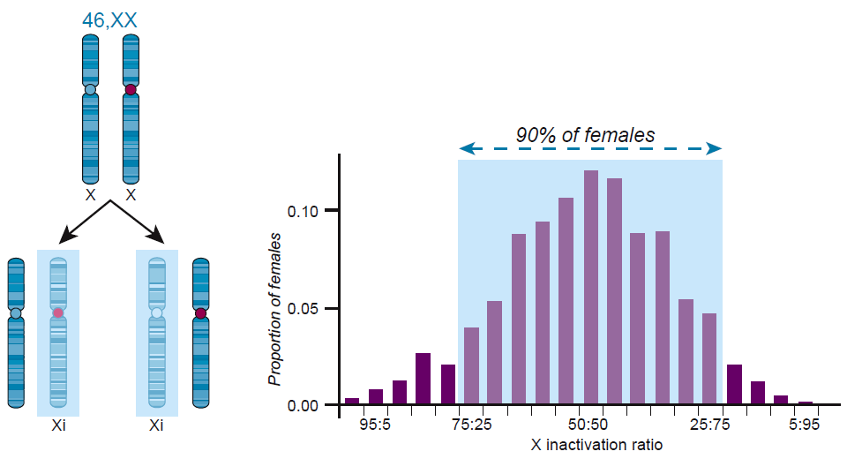
Homozygous females and manifesting heterozygote
Figure 6-13 X chromosome inactivation in karyotypes with normal chromosomes. Normal female cells (46,XX) undergo random X inactivation, resulting in a mosaic of two cell populations (left) in which either the paternal or maternal X is the inactive X (Xi, indicated by shaded box). In phenotypically normal females, the ratio of the two cell populations has a mode at 50:50, but with variation observed in the population (right), some with an excess of cells expressing alleles from the paternal X and others with an excess of cells expressing alleles from the maternal X.

Slide 23
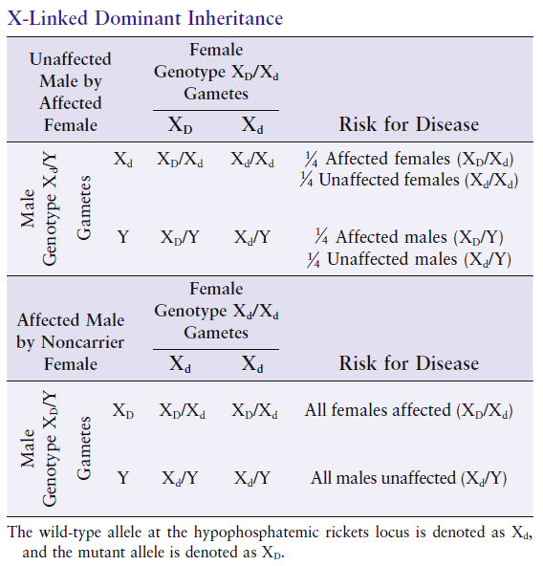

Slide 24
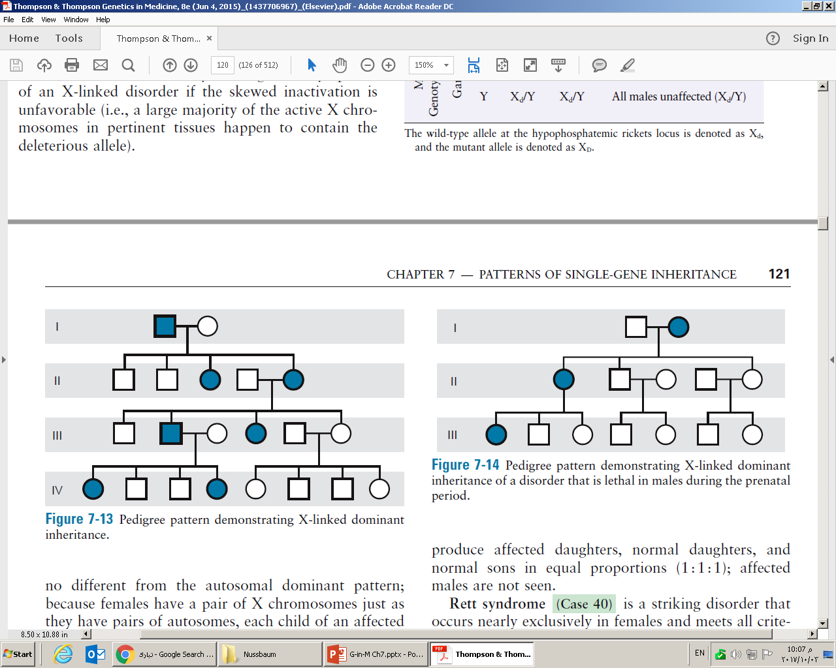
Lack of male-to-male transmission
All daughters and none of the sons of affected males are affected
Most are incompletely dominant

Slide 25
X-linked dominant with male lethality
Rett syndrome
MECP2

Slide 26
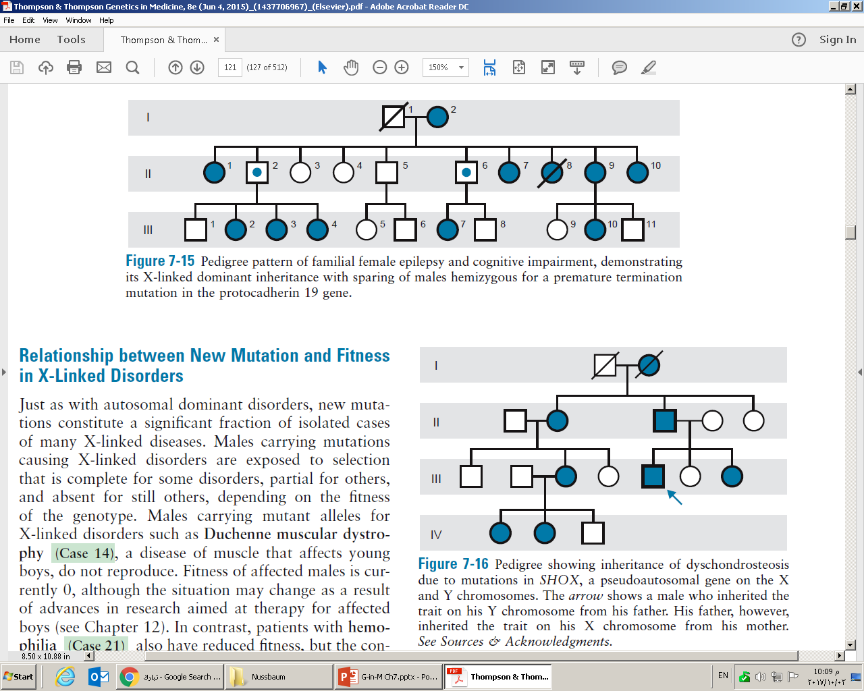
X-linked dominant with male sparing
Explanation is unclear
Hypothesis:
Females mosaicism disrupts communication between groups of neurons with and without the cell surface protein
Males uniformly lack protein but brains are spared cell miscommunication by a different, compensating protocadherin

Slide 27
Duchenne muscular dystrophy has a fitness of 0
Hemophilia has a fitness of 70%
When fitness is reduced, mutant alleles of males are lost from population
However, mutant alleles in females maybe partially or completely protected from selection

Slide 28
Pseudoautosomal inheritance

Slide 29
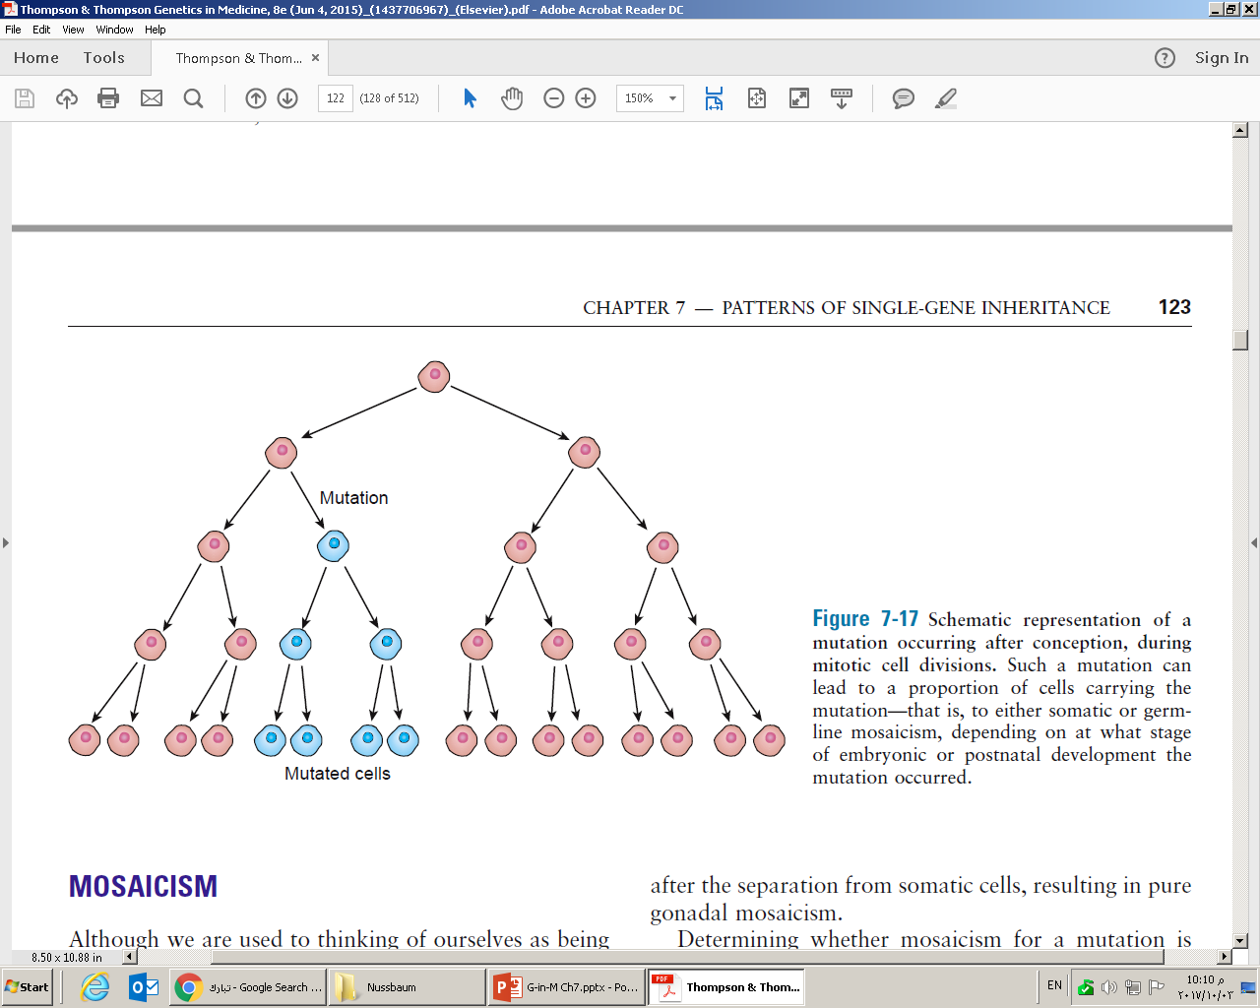
Mosaicism
Somatic mosaicism
Germline mosaicism

Slide 30
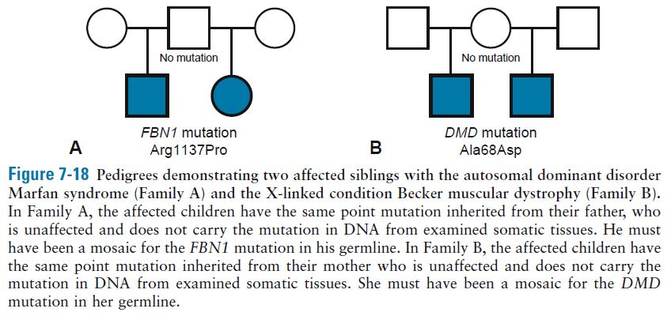
Germline mosaicism

Slide 31
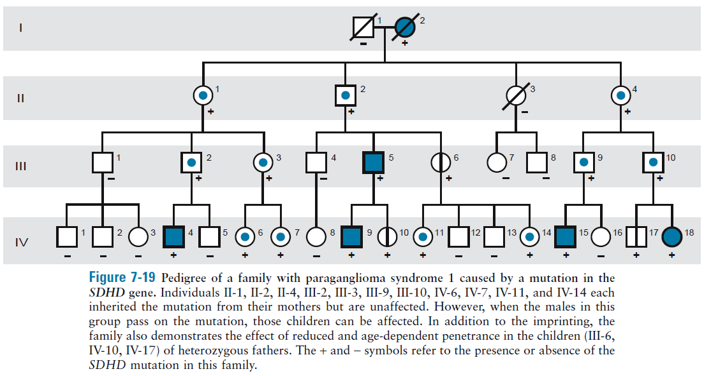
Parent-of-origin effects on inheritance patterns
Unusual inheritance pattern due to genomic imprinting
Affected only if the mutation is inherited from the father

Slide 32
Dynamic mutations
Polyglutamine disorders
Huntington disease
Motor Abnormalities
Personality changes
Gradual loss of cognition
Death
Anticipation
Parental transmission bias
Normal 9-35 CAGs
Affected ≥40
Premutations

Slide 33
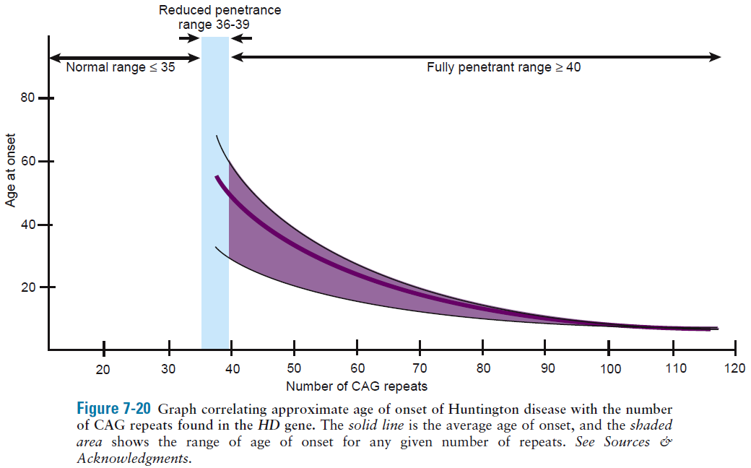

Slide 34
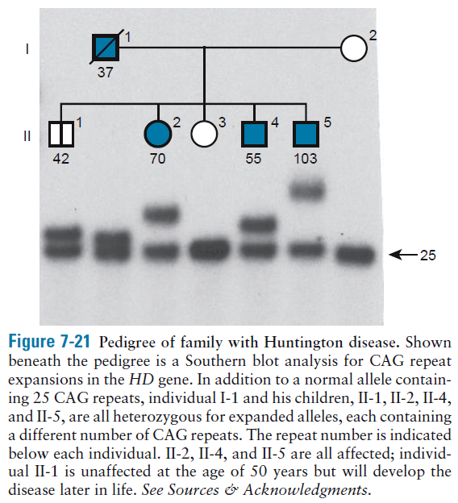

Slide 35
Fragile X syndrome
Most common heritable form of moderate intellectual disability
Penetrance in females in the 50%-60% range
Frequency 1 in 3000-4000 male births
CGG in the 5’ UTR of FMR1
Normal ≤55 repeats
Affected >200 repeats
Premutation 56-200
Mother to child

Slide 36
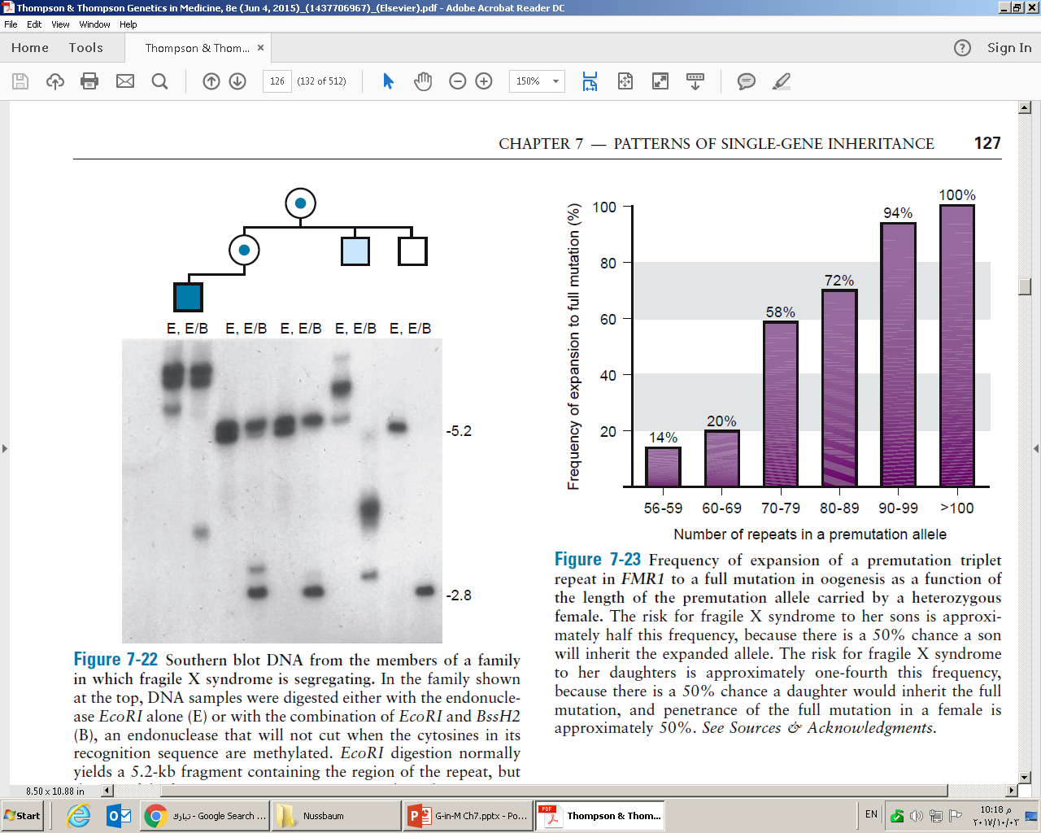
EcoRI yields 5.2-kb fragment
BssH2 yields 2.8-kb but will not cut if methylated

Slide 38
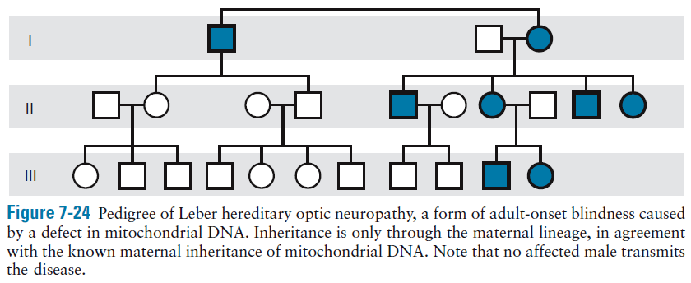
Maternal inheritance of mtDNA

Slide 39
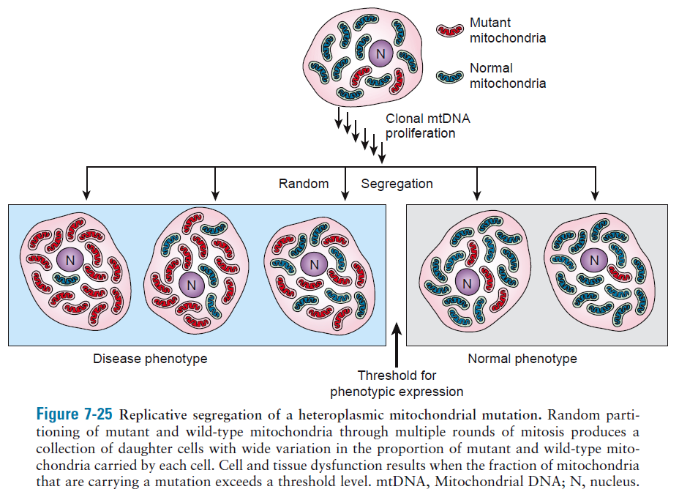
Replicative segregation
Homoplasmy – Heteroplasmy
Mitochondrial genetic bottleneck

Slide 40
Allelic heterogeneity
Locus heterogeneity
Clinical or phenotypic heterogeneity

